Slide 1
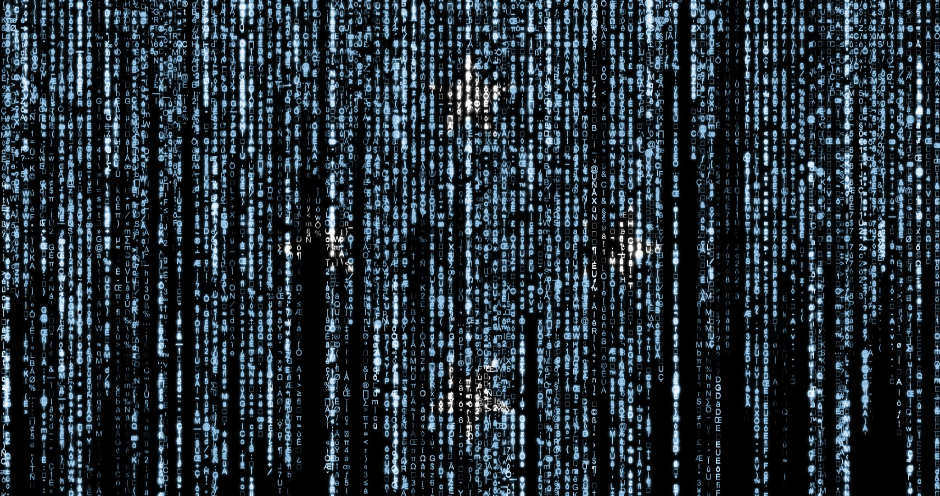
Introduction to Cryptology IT-233 Yosef Mendelsohn
Lecture #5:
Introduction to Cryptology:
Shakespeare, Jefferson, et al
Etc

Slide 2
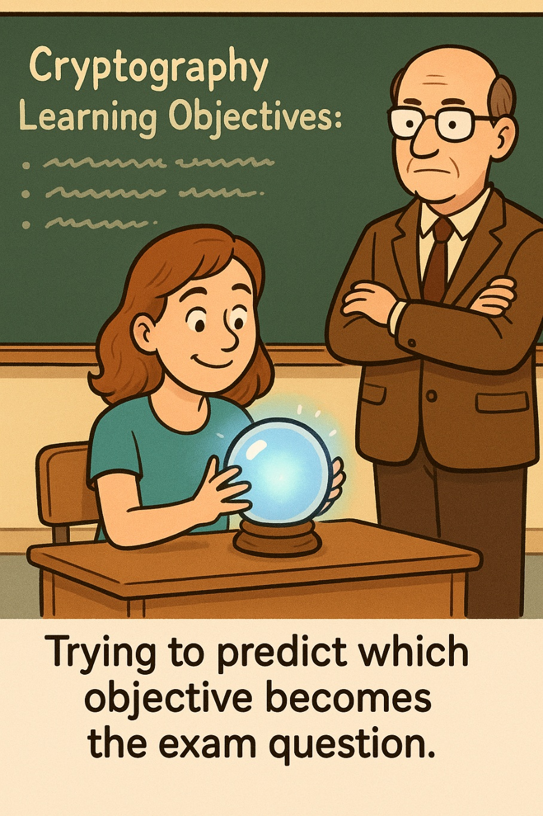
Lecture objectives
Blah
More blah

Slide 3
overview

Slide 4

Many thanks to Professor Joe Phillips who provided the original version of several of the slides used in this lecture.

Slide 5
Introduction
So far, we have discussed:
Steganography: Hiding Content
e.g. Writing on tablets, then covering with wax
Substitution Ciphers
Monoalphabetic Substitution Ciphers, aka “MASCs” (e.g. Caesar Cipher)
Vigenère Cipher
One-Time Pads
Transposition Ciphers
Skytale
Rectangular and Columnar Transposition Ciphers
And we have not even gotten to the 20th Century yet!

Slide 6
Other Old-Time Ciphers
Bacon’s Binary Cipher
Cipher Wheel
Playfair Cipher

Slide 7
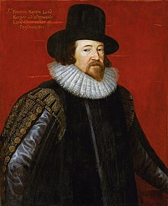
Bacon’s Binary Cipher
Sir Francis Bacon (1561-1626)
Philosopher
Developed empiricism and the scientific method
Some have tried to claim that he was the “true” author of Shakespeare’s plays
The evidence to support this is extremely flimsy!
. . . and cryptographer!

Slide 8
Bacon’s Binary Cipher
Impressive because only two symbols are needed to convey the message
Assign every letter a binary number pattern
We will revisit binary encoding later in the course
A | aaaaa | N | abbab
B | aaaab | O | abbba
C | aaaba | P | abbbb
D | aaabb | Q | baaaa
E | aabaa | R | baaab
F | aabab | S | baaba
G | aabba | T | baabb
H | aabbb | U | babaa
I | abaaa | V | babab
J | abaab | W | babba
K | ababa | X | babbb
L | ababb | Y | bbaaa
M | abbaa | Z | bbaab

Slide 9
Bacon’s Binary Cipher
Might be thought of as a form of MASC (albeit with long substitutions for each letter)
However, was intended as a form of steganography
For example,
“a” can be one font or character type
“b” can be another
Of course, could use any distinguishing feature
A | aaaaa | N | abbab
B | aaaab | O | abbba
C | aaaba | P | abbbb
D | aaabb | Q | baaaa
E | aabaa | R | baaab
F | aabab | S | baaba
G | aabba | T | baabb
H | aabbb | U | babaa
I | abaaa | V | babab
J | abaab | W | babba
K | ababa | X | babbb
L | ababb | Y | bbaaa
M | abbaa | Z | bbaab

Slide 10
Bacon’s Binary Cipher: Example
Consider:
Joe will help in the heist. He’s a good man and he knows a lot about bank security.
Note how some letters are in bold and others are not. Now, ignoring the actual text of the message, simply note which letters are bold and which are not. Treat each regular letter as an ‘a’ and each bolded letter as a ‘b’. The message has been encoded in 5-character increments so as to work with the Bacon’s binary cipher.
Consider the first 6 letters in which the last two letters are in bold: Joewi
This corresponds to: aaaabb → D
llhel → abbba → O
pinth → abbab → N
Don’t trust Joe
A | aaaaa | N | abbab
B | aaaab | O | abbba
C | aaaba | P | abbbb
D | aaabb | Q | baaaa
E | aabaa | R | baaab
F | aabab | S | baaba
G | aabba | T | baabb
H | aabbb | U | babaa
I | abaaa | V | babab
J | abaab | W | babba
K | ababa | X | babbb
L | ababb | Y | bbaaa
M | abbaa | Z | bbaab

Slide 11

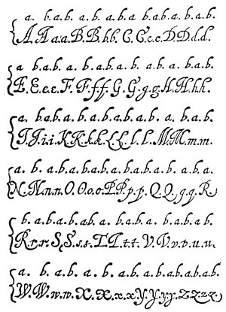
Obvious Much?
Definitely!
Turns out, the creativity in hiding the A/B patterns is a key element of the cipher that makes it so interesting.
Some historical examples (ranging from obvious to subtle)
Different fonts
Serif vs. Non-serif
Spacing
Handwriting: Use “formal” vs. “quick” hand
Spacing variants (can be very subtle, “microspacing”)
Impression pressure
Baconian cipher technique was more effective in earlier times with more primitive printing press machines in which some variation in impressions was normal and expected.

Slide 12
Exercise (with a twist)
Key:
“Courier New” font
non-bold letter → a
bold letter → b
Prof Bob is an excellent teacher. I cannot recommend his course highly enough!
Answer:
aaabb baaab abbba abbbb baabb aabbb aabaa aaaba ababb aaaaaa baaba baaba bbbb
Drop the class!
In other words, even this seemingly obvious cipher can be made (ever so slightly) more secure by being a bit more subtle with the steganography.
A | aaaaa | N | abbab
B | aaaab | O | abbba
C | aaaba | P | abbbb
D | aaabb | Q | baaaa
E | aabaa | R | baaab
F | aabab | S | baaba
G | aabba | T | baabb
H | aabbb | U | babaa
I | abaaa | V | babab
J | abaab | W | babba
K | ababa | X | babbb
L | ababb | Y | bbaaa
M | abbaa | Z | bbaab

Slide 13
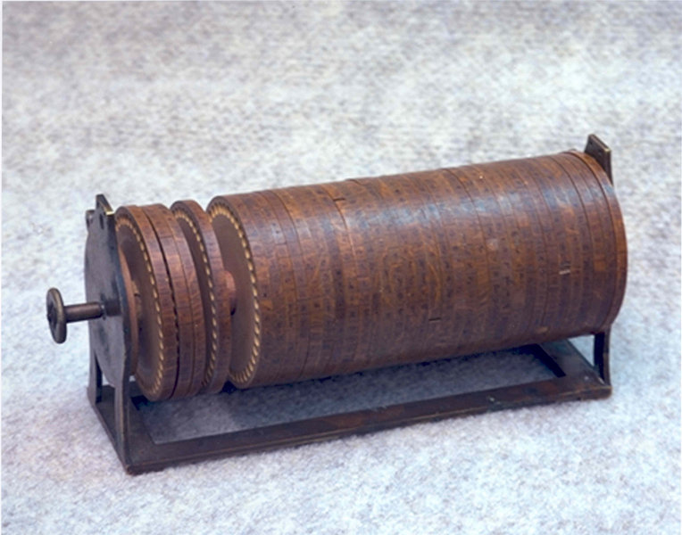
Wheel Ciphers
Also known as “Jefferson Disk” (after Thomas Jefferson – even though it predated him by years) or “Bazeries Cylinder”
Reintroduced with modifications by numerous people (including Thomas Jefferson)

Slide 14
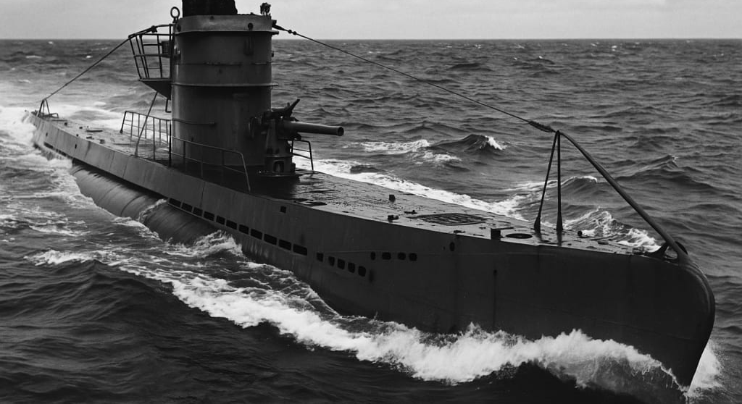
Wheel Cipher
Single axle on which multiple wheels are placed – in any order – which is where a large part of the keyspace comes from.
Every wheel lists all of the alphabet in scrambled order
The ability to reorder the wheels foreshadows the famous Enigma machine which had powerful military implications centuries later

Slide 15
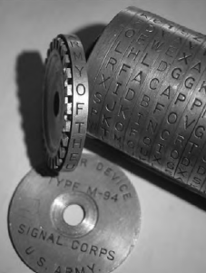
Wheel Cipher Evolution: M-94
Used until the middle of WW2 and a version of it existed in military use as late as the 1960s.

Slide 16
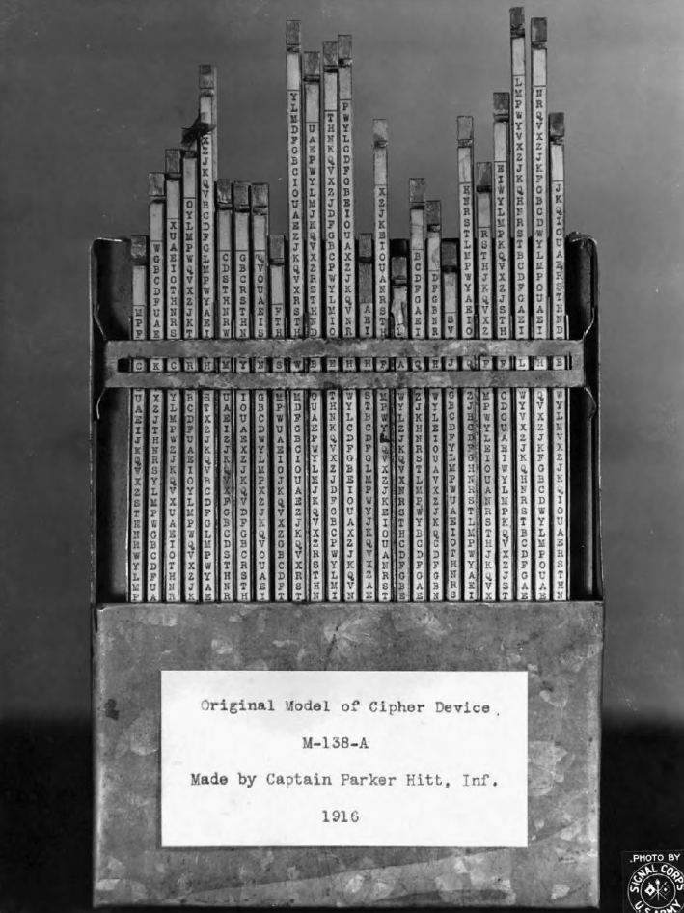
Wheel Cipher Evolution: M-138-A
Sliding the strips up and down is analogous to turning the wheels on the Jefferson wheel.
Switching the strips to different locations in the box is analogous to switching the order of wheels on the Jefferson wheel.
Cracked by Germany’s “Per Z S” code-breaking group of Foreign Office in 1944

Slide 17
Wheel Cipher: Cryptanalysis
Key space: if n represents the number of wheels, then n! possible wheel arrangements
Key: Arrangement (order) of the wheels

Slide 18
Wheel Cipher: Cryptanalysis
Weakness:
Offset from plaintext to ciphertext will be same on all wheels
Suppose that:
We have eavesdropped on a transmitted ciphertext. (Pretty easy to do).
We have captured a wheel. (Some were in widespread use, so this too is not unrealistic).
As we’ve seen multiple times in the course, one of the most effective means of attack is to guess at a likely crib.
E.g. “aircraft”

Slide 19
Example: Wheel Cipher: Cryptanalysis
In-class: Work through section 4.3
This is not something you will be asked to know about on exams.

Slide 20
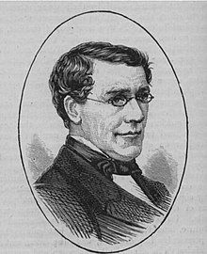
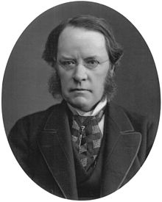
Playfair Cipher
Actually invented by Charles Wheatstone
Popularized by his friend Lyon Playfair

Slide 21
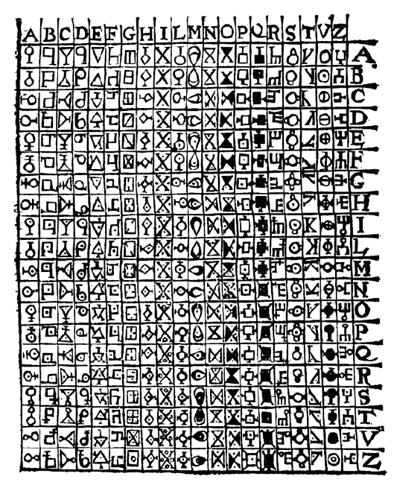



Playfair Cipher: Early Version
Digraphic Substitution: 2 letters substituted for at a time
Early versions did not use a key making them somewhat awkward to use
Example: Let’s encode “REVOLT”
RE →
VO →
LT →
Unicity point (discussed next) for a random digraphic cipher such as this one is 1,460.61. In other words, we would need about 1461 characters of ciphertext if we hope to obtain a unique solution.
Porta’s cipher – believed to be the first digraphic cipher

Slide 22
Unicity Point
Introduced by Claude Shannon, the unicity point is the minimum amount of ciphertext required so that, statistically, only one key is consistent with the ciphertext.
Before this amount, many keys might “work” and produce something that looks like possible English.
After this number of characters, only one key fits, making the cipher uniquely solvable (in principle).
This doesn’t mean the cipher is instantly crackable — just that the ciphertext contains enough information to rule out all but one key.
An important concept in cryptology because it connects:
the amount of redundancy in the language (like English)
the size of the keyspace
the amount of ciphertext needed for a unique solution

Slide 23
Playfair Cipher
Idea:
Substitute pairs of letters as determined by a 5x5 grid
Consider “BONJOURX”
“X” added to ensure an even number of letters
Split message into pairs of letters
A | B | C | D | E
F | G | H | I&J | K
L | M | N | O | P
Q | R | S | T | U
V | W | X | Y | Z
BONJOURX
BO =>
NJ =>
OU =>
RX =>

Slide 24
Playfair Cipher
Split message into pairs of letters
“BO” defines the corners of a box
Replace with the other corners
Could be “DM” or “MD”
By convention first cipher letter (“D”) should be from same row of first plain letter (“B”)
“BO” => “DM”
A | B | C | D | E
F | G | H | I&J | K
L | M | N | O | P
Q | R | S | T | U
V | W | X | Y | Z
BONJOURX
BO => DM
NJ =>
OU =>
RX =>

Slide 25
Playfair Cipher
Split message into pairs of letters
“NJ” defines the corners of a box
“O” and “H” define other corners
“O” is in same row as “N”
“NJ” => “OH”
A | B | C | D | E
F | G | H | I&J | K
L | M | N | O | P
Q | R | S | T | U
V | W | X | Y | Z
BONJOURX
BO => DM
NJ => OH
OU =>
RX =>

Slide 26
Playfair Cipher
Split message into pairs of letters
“OU” defines the corners of a box
“T” and “P” define other corners
“P” is in same row as “O”
“OU” => “PT”
A | B | C | D | E
F | G | H | I&J | K
L | M | N | O | P
Q | R | S | T | U
V | W | X | Y | Z
BONJOURX
BO => DM
NJ => OH
OU => PT
RX =>

Slide 27
Playfair Cipher
Split message into pairs of letters
“RX” defines the corners of a box
“S” and “W” define other corners
“S” is in same row as “R”
“RX” => “SW”
A | B | C | D | E
F | G | H | I&J | K
L | M | N | O | P
Q | R | S | T | U
V | W | X | Y | Z
BONJOURX
BO => DM
NJ => OH
OU => PT
RX => SW

Slide 28
Playfair Cipher
BONJOURX => DMOHPTSW
A | B | C | D | E
F | G | H | I&J | K
L | M | N | O | P
Q | R | S | T | U
V | W | X | Y | Z
BONJOURX
BO => DM
NJ => OH
OU => PT
RX => SW

Slide 29
Playfair Cipher: Same row / column?
Same row?
Use letters directly to the right
MO => NP
OM => PN
Same column?
Use the letters directly below
SH => XN
HS => NX
If at any point, you reach the end of a row or column, circle around to the left or top to continue.
A | B | C | D | E
F | G | H | I&J | K
L | M | N | O | P
Q | R | S | T | U
V | W | X | Y | Z
A | B | C | D | E
F | G | H | I&J | K
L | M | N | O | P
Q | R | S | T | U
V | W | X | Y | Z
Note: The above applies to EN-cipherment. When DE-ciphering we must not forget to use the letters to the left (if working with a row), or above (if working with a column).

Slide 30
Playfair Cipher: Repeated Letters
Break them up by inserting “X” between them
In English, “X” is rare, so they can easily be identified and ignored
Example:
“HELLO”
A | B | C | D | E
F | G | H | I&J | K
L | M | N | O | P
Q | R | S | T | U
V | W | X | Y | Z
“HELLO” => “HELXLO”
HE => KC
LX => NV
LO => MP
“HELLO” => “KCNVMP”

Slide 31
Playfair Cipher: Use of a Key
The Playfair squares we have seen aren’t even truly ciphers as anybody can reconstruct them. To turn them into ciphers, we must use a key of some kind.
For our key, we encipher with the password “pasword”
Notice: only one “s”
Unicity point of a Playfair that uses a key such as this one is about 23.
P | A | S | W | O
R | D | B | C | E
F | G | H | I&J | K
L | M | N | Q | T
U | V | X | Y | Z
As we’ve seen with other ciphers, we start with the key, ignoring repeated letters. Once the key is complete, we continue with the remainder of the alphabet, skipping over any letters that were used in the key.

Slide 32
Exercise:
Create a Playfair cipher using the key: “Mount Everest”
Answer / Notes:
Note that we skip a couple eof “E”s, and a “T” since they are repeated.
Once we have completed the key, we start at the top of the alphabet and continue through the end, again ignoring all repeated letters.
Don’t forget to combine I and J
M | O | U | N | T
E | V | R | S | A
B | C | D | F | G
H | I/J | K | L | P
Q | W | X | Y | Z

Slide 33
Exercise: Encipherment
Using a Playfair cipher with key: “Mount Everest”, encipher the following:
“Always listen to your Sherpa”.
Answer / Notes:
AL → SP
WA → ZV
YS → same column, use the letters below: NF
LI → same row, use the letters to the right: KH
ST → AN
EN → SM
TO → MU
YO → WN
UR → RD
SH → LE
ER → VS
PA → ZG
M | O | U | N | T
E | V | R | S | A
B | C | D | F | G
H | I/J | K | L | P
Q | W | X | Y | Z

Slide 34
Exercise: Decipherment
Decipher the ciphertext below using the key: “pasword”
Note: Don’t forget that when decrypting the “special cases” (e.g. same row, same column) must be done in reverse from what was done during encipherment.
P | A | S | W | O
R | D | B | C | E
F | G | H | I&J | K
L | M | N | Q | T
U | V | X | Y | Z
EWMHDPLZMPKWXBKPDBREFWKBCFMH
Answer/Notes:
I sometimes like to write out the message with seperators like so:
EW/MH/DP/LZ/MP/KW/XB/KP/DB/RE/FW/KB/CF/MH
CO NG RA TU LA IO NS FO RD EC IP HE RI NG –> Congratulatons for deciphering
For the “IO”, I pucked the “I” since at the end of the decryption, it made more sense than “JO”!
Do decipher XB, remember that we need to use the letters above during decryption.
To decipher DB, remember we need to use the letters to the left during decryption.

Slide 35
History: Playfair Usage
Saw a fair amount of real-world usage in Pacific Theater during World War II
Key: “Royal New Zealand Navy”
May well have saved the life of President John F. Kennedy when his PT Boat was sunk
R | O | Y | A | L
N | E | W | Z | D
V | B | C | F | G
H | I&J | K | M | P
Q | S | T | U | X
Practice: Decipher the first few words of the encrypted text:
KXJEYUREBEZWEHEWRYTU

Slide 36
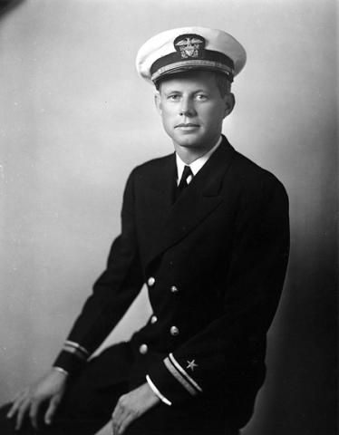
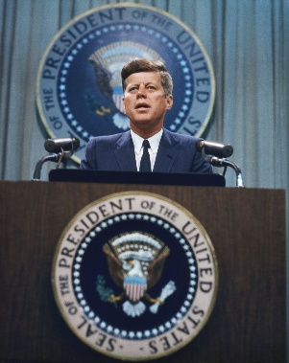
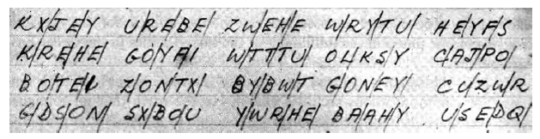
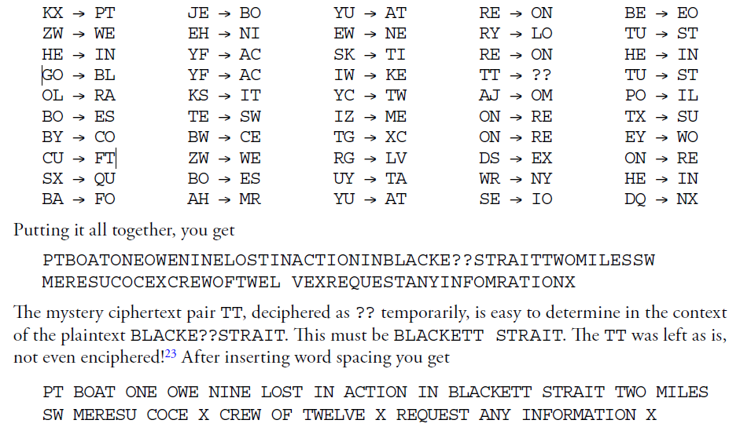
Did the Playfair Cipher Save A President?
Playfair message sent during WW2 in the Pacific Theater
The message was sent after John F. Kennedy’s patrol torpedo (PT) boat had been sliced in half by a Japanese destroyer. More messages followed and eventually allowed the crew, which had swum ashore, to be rescued from the behind enemy lines. It is entirely possible that the failure of the Japanese to read this (and other messages) may have saved the life of a future American president.

